Slide 1
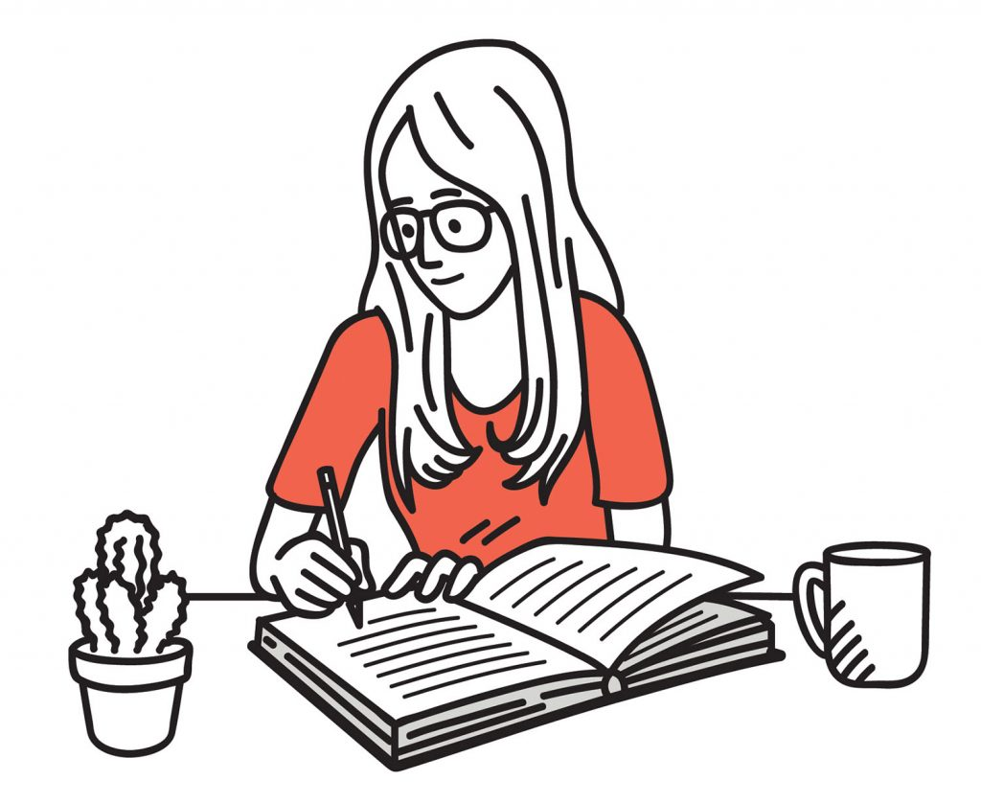

The Science of Learning
How memory works
Understanding the basics of memory, helps you understand how someone should learn and revise
Short Term Memory – ‘Working Memory’
This is where you do your thinking and where you take in new information e.g. what you see/hear/experience
Unless you think about it, most of it is forgotten
It holds a limited amount of information, and can get overloaded!
Long Term Memory
This is where new information is stored, what you have learned – when you remember something, it comes from here
It can hold an endless amount of information
The information gets forgotten if we don’t use it
Learning =
Learning = a change in your long term memory
Notes:
Short Term Memory
This is where you do your thinking and where you take in new information e.g. what you see/hear/experience
Unless you think about it, most of it is forgotten
It holds a limited amount of information, otherwise is gets overloaded and doesn’t learn anything. So, cramming is a bag idea!
Long Term Memory
This is where new information is stored, what you have learned – when you remember something, it comes from here
It can old an endless amount of information
The information gets forgotten if we don’t use it
Learning
Learning = a change in your long term memory
For information or skils to be learnt and stored in your long-term memory, the mind must work hard.
Therefore, when doing any revision activity, you must do things which actively make you think hard!

Slide 2
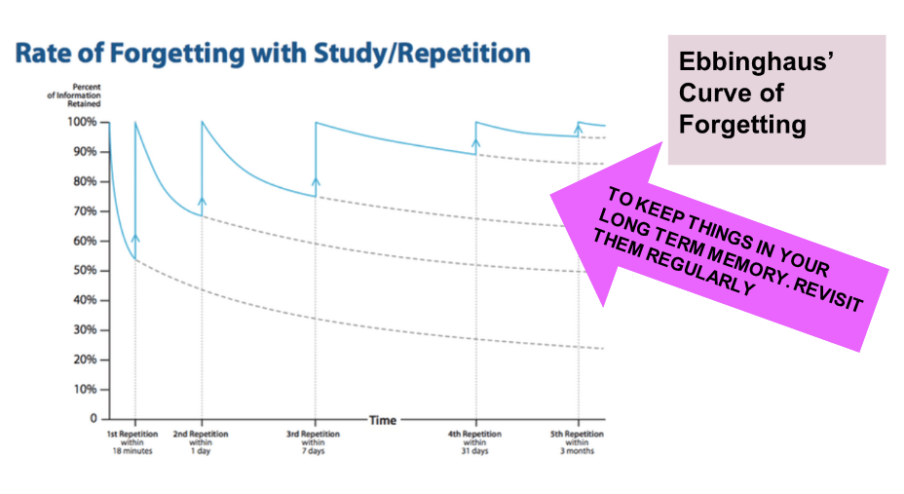
Forgetting and Retrieval
Notes:
We also know that information and skills are naturally forgotten if not revisited or practiced.
Research shows that over time you foget a majority of what you’ve learnt, it happens immediately.
Practice and retrieval helps break the forgetting curve and it strengthens long term memory – it stops the information ‘fading’ from your long-term memory
Retrieval helps organize information in your memory, making it easier and quicker to remember in the future
Retrieval helps you learn even more, knowledge is sticky!

Slide 3
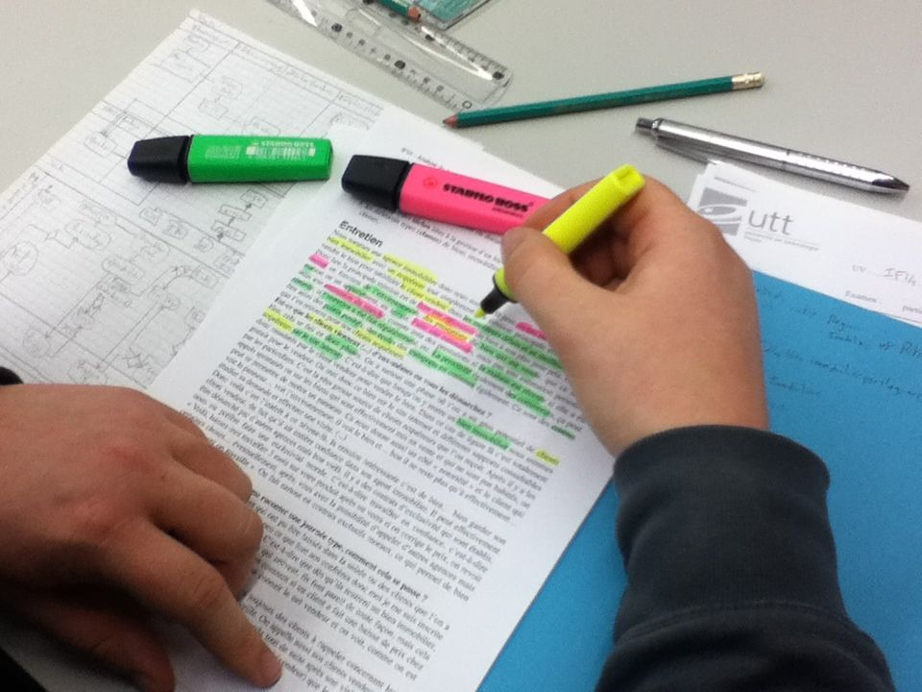
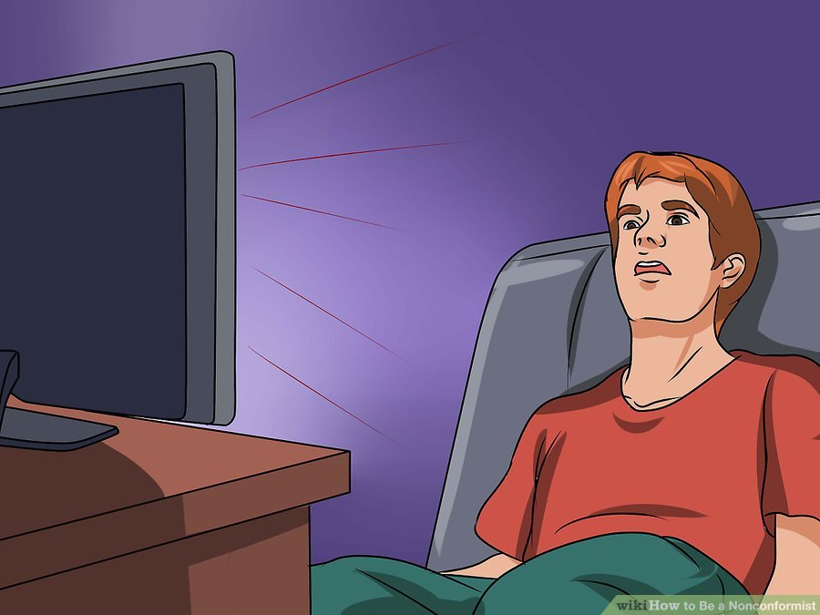
What does not work?
Re-reading
Highlighting
Cramming
Re-Writing
Notes:
What we know doesn’t work
The science of learning has also told us there are several ineffective revision strategies which remain popular. Students often feel as they have been ‘busy’ doing these, they are revising hard. However, they have little impact
Re-reading – this gives a false sense that you ‘know it’. However, your brain isn’t doing any hard work or learning
Highighting – it wastes time and leaves you focusing on a narrow area, often missing the big picture of the notes
Cramming – This essentially overloads your working memory, you cant learn it all. It causes stress/anxiety before exams
Re-writing – writing out your notes again isn’t making your brain do any hard work, it simply wastes time.

Slide 4

Pod Revision Method 2 – The Power of Symbols
The Science
Research has found that the brain can process images and store them in its long-term memory systems after only seeing them for a small amount of time.
Long-term image memory rates also increase when a person sees the same object, or scene, multiple times
So, revising with images or symbols and revisiting these images and symbols means information associated with them is stored in your long-term memory. Perfect for revision!

Slide 5
Pod Revision Method 2 – The Power of Symbols - I
Watch a topic, title or single Pod and create a set of around 6–8 symbols to represent the key pieces of information. Annotate your symbols.
Notes:
Choose a pod to watch with the class (from your subject area or any relevant to all pupils such as keeping fit and heathy, study smart or British values)
With the class, model how you would draw small images to help you remember the content of the pod
After, annotate the images to show the class why you chose them

Slide 6
Pod Revision Method 2 – The Power of Symbols - We
Choose another pod to watch as a class.
This time, together we will choose what symbols to draw to help us remember the information.
Let’s annotate the symbols together.
Notes:
Choose another pod. This time, take feedback from the class and create the images and annotations together, stopping the pod to discuss what to draw and annotate

Slide 7
Pod Revision Method 2 – The Power of Symbols - You
Finally, choose a third pod to watch.
This time, work independently to draw and annotate your symbols.
This revision method is proven to help commit information into your long-term memory

