Slide 1
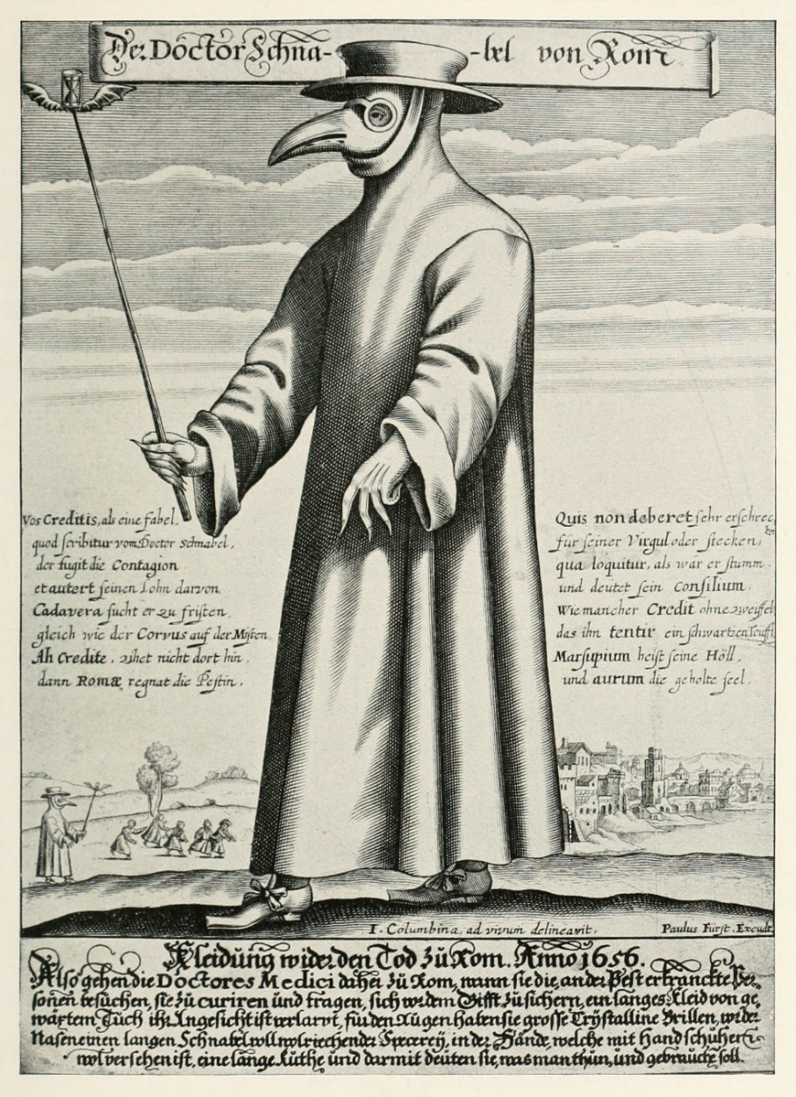
Medicine Revision Booklet
Name: .
Topic | Confidence
 | R | A | G
Causes
Prevention
Treatment and cures
Medical Knowledge
Patient care
Public Health
Study of a historic environment: The British sector of the Western Front

Slide 2
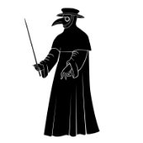
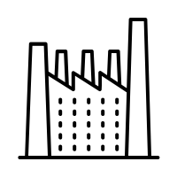
Causes
Middle Ages (1000 – 1500)
Poverty and poor living conditions have helped cause illness and disease throughout the period.
Accidents, warfare and famine caused illness
People thought that disease was caused by bad smells (miasma)
People thought that God or magic would make them sick
The Black Death in 1348 was spread by fleas on rats. It killed one third of the population.
Imbalance of the Four Humours
Early Modern (1500 – 1750)
In 1665 the Great Plague was spread by fleas on rats however people still thought that bad smells or cats and dogs were the cause.
Industrial Age (1750 – 1900)
The growth of industry led to multiple issues e.g. pollution, greater risk of injury at work and lack of safety regulation + child labour meant that they grew up with deformed spines and limbs
Dangerous jobs such as matchstick making led to phossy jaw, factory workers would often lose limbs.
Unhealthy towns and cities led to epidemics e.g. typhoid and cholera
20th C/ 21st C (1900- present)
In 1918 Spanish Influenza was spread during WW1
Aids in the 20th century, causes by lifestyle choices e.g. unprotected sex and drugs
Poor diets and unhealthy lifestyles are a major cause if illness today

Slide 3
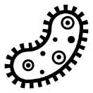
Preventions
Middle Ages 1000-1500
Avoid sex, drink urine, pray, flagellate (Whip themselves)
See a soothsayer- people who could see the future e.g. Mother Shipton
See alchemists- people who turned metal into gold and searched for the elixir of life
Balancing of the Four Humours
Industrial Age 1750-1900
People used cold water treatment to prevent getting sick. This involved bathing in cold water and eating cooling foods.
Edward Jenner introduced a prevention to smallpox by injecting people with cow pox. He invented the vaccine.
John Snow introduced a prevention to catching cholera by removing the handle off a water pump but both could not explain how it worked due to a lack of scientific understanding.
Louis Pasteur’s germ theory and Robert Koch’s development of bacteriology also altered the way people thought about illness and disease
Pasteur invented a vaccine for rabies and Koch discovered a TB vaccine.
20th C/ 21st C 1900- present
Because of vaccination, diseases like smallpox and polio are very uncommon.
Child mortality dropped as a result of vaccinations.
In the 1990s Dr Wakefield said that the MMR vaccine caused autism.
Today vaccination rates are not as high as they need to be to stop epidemics and outbreaks of Measles is becoming a problem.

Slide 4
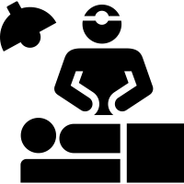
Treatment
Middle Ages 1000-1500
During the Medieval period herbs were used, many herbal remedies
A favoured way of treating illness was to use bleeding during this period
Leeches were used
There was still a lot of superstition as is shown through the use of zodiac charts
Many people could not afford a Physician so barber surgeons and Apothecaries
Early Modern 1500-1750
Discoveries from the new world were used in medicine such as tobacco and rhubarb.
Transference was popular where you would rub the effected area on an object like an onion and pass on the illness to the vegetable.
Industrial Age 1750-1900
James Simpson’s development of anaesthetics and Joseph Lister’s development of antiseptics in the 19th century brought huge changes to treating illness through surgical operations which previously hadn’t been an option.
Aseptic techniques such as sterilisation improved survival rates to those undergoing surgery.
Joseph Lister used carbolic acid as an antiseptic. He is known as the ‘father of antiseptics’.
20th C/ 21st C 1900- present
Alexander Fleming’s discovery of penicillin and Florey and Chain’s work on making penicillin an effective antibiotic meant that infections could be successfully treated.
20th century technology and discoveries have transformed the treatment of disease e.g. Marie Curie and the development of radiation.
Christian Barnard and transplant surgery, chemotherapy to kill cancerous cells.
Despite all the advances some people still prefer to use non – invasive natural approaches to treating illness and there is a growing belief in the value of alternative medicine e.g. acupuncture, yoga, hypnotherapy, aromatherapy etc.

Slide 5
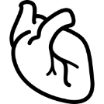
Medical Knowledge
Middle Ages 1000-1500
Common medical ideas in the Middle Ages still centred around the theory of the four humours introduced by Hippocrates in the ancient period, and this was continued by Galen.
All doctors were trained by the church and human dissection was forbidden
The study of astrology to explain or cure illness was common
Alchemists attempted to turn base metals to gold and find the elixir of life
Early Modern 1500-1750
It was during the Renaissance period (1500 -1700) that people started to question the wisdom and beliefs of the ancient world.
Andreas Vesalius developed a much more accurate understanding of how the human body was made up (anatomy). He published a book ‘The Fabric of the Human Body’. He found that Galen made many mistakes about the human body.
Ambroise Pare used ligatures to tie up arteries during surgery
William Harvey discovered how the blood circulates around the body with the heart acting as a pump.
Industrial Age 1750-1900
Louis Pasteur was able to prove that germs in the air caused illness and disease and was able to back up his germ theory through evidence.
Robert Koch identified specific germs that caused specific diseases e.g. tuberculosis. He introduced the science of bacteriology and was able to explain how antibodies worked.
Paul Ehrlich’s discovery of the cure for syphilis SALVASAN 606 brought change to knowledge and understanding
20th C/ 21st Century 1900- present
Improved understanding of what was happening inside the human body was brought about by new techniques such as X rays, ultrasound, MRI, PET and CT scanning. All these revolutionised the way in which Doctors identify and diagnose illness.
DNA and genetic engineering have provided further advances in the understanding of illness. People can be screened for genetic diseases.

Slide 6
Patient Care
Middle Ages 1000-1500
In Medieval times the church played a central role in providing hospitals and looking after the sick e.g. monasteries, alms-houses, Christian hospitals.
These places did not provide cures but instead looked after those who were ill. Main source of treatment involved food, water and strict worship.
Industrial Age 1750-1900
During the 18th century a growing number of hospitals were built and financed by wealthy people, local charities and town councils, these were known as endowed hospitals. Philanthropists were keen to fund new hospitals and specialist hospitals.
The Crimean war helped change nursing care and this was largely down to the work of Florence Nightingale.
Nightingale cleaned the hospital and separated patients according to disease. She influenced the design of hospitals and training of nurses. In 1850 there were no trained nurses in Britain but by 1901 there were 68,000.
Early Modern 1500-1750
In the 1530s Henry VIII closed down all of the monasteries.
The church no longer ran hospitals and the role had to be taken on by charities.
In London, the King paid for 5 hospitals to be opened:
St Bartholomew’s- looked after the poor
St Mary Bethlehem- looked after the insane
St Thomas hospital- looked after the sick, poor and VD patients
Christ’s hospital- looked after and educated fatherless children
Bridewell hospital- looked after homeless children and punished the disorderly poor.
20th C/ 21st C 1900- present
The Government changed its attitude and started to take responsibility for the welfare of the people. In 1911 the Liberal Government introduced the National Insurance Act which provided free medical treatment for those who paid into the insurance scheme.
In 1942 William Beveridge suggested a welfare state when he published a report which identified five evil giants (want, squalor, idleness, ignorance and disease) and recommended the Government take action against these and establish a national system of free medical care.
In 1948 the NHS was created which offered free medical care from the cradle to the grave at the point of need.
The NHS was popular with the general public but the BMA, local authorities and charities were against it.

Slide 7
Public Health
Middle Ages 1000-1500
During the Middle ages towns were very unhealthy, people lived alongside animals, there was no proper sewage or refuse disposal.
Coventry council cleaned up the city:
Every man had to clean the street in front of their house or be fined.
Street cleaning and waste disposal.
Banned waste in the river
Moved toilets that were over a stream
Waste disposal locations were set up
Early Modern 1500-1750
Henry VII forbid slaughter houses in the city
Henry VIII built sewers
After the Great Fire of London 1666, London was rebuilt. Streets were wider, made of stone.
Industrial Age 1750-1900
The Government had a Laissez- faire (leave it alone). Landlords could build quick, unsafe housing and encourage large numbers of people to live in their properties in order to make as much profit as possible with very little care about people’s welfare.
Edwin Chadwick campaigned for the Public Health Act. The Public Health Act 1848. The act allowed local councils to improve conditions in their own town if they wished. It only recommended change it did not force it.
The Second Public Health Act 1875 had more power. It brought together other acts about sewage, drains and water. Councils were forced to provide clean water, cover sewers, collect rubbish and provide street lighting.
20th C/ 21st C 1900- present
During the 20th century the government made great efforts to improve public health. WW1 prompted change and the government passed the housing act of 1919 that set up a house building scheme designed to provide homes fit for heroes.
The damage and destruction of WW2 meant that the government introduced house building schemes designed to provide affordable housing of a higher quality
During the 1950’s and 1960’s the emphasis of the government was on slum clearance and many new towns were created in an attempt to improve living conditions e.g. Milton Keynes.
The Clean Air Act 1956- cut smoke pollution in cities.
The problem today is poor lifestyle which reduces life expectancy e.g. eating too much, drinking too much alcohol, smoking, drug taking, not enough exercise etc.. As a result people are reminded of the values of healthy.

Slide 8
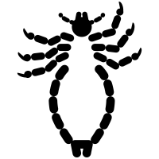
The British sector of the Western Front: Injuries
Gas
Environmental Illness
Trench fever
This was used for the first time in 1915 – victims would suffer horrendous skin, eye and respiratory injuries. (mustard gas, phosgene gas and chlorine gas) Phosgene and chlorine gas was also extremely deadly, causing severe pain before the victim died.
Cause by lice bites. It would often cause mental breakdowns which would require significant time away from the trenches to receive extremely crude treatment for the time before being sent back to the front often without actually getting better.
Trench foot, frostbite, infection, body lice all caused severe pain and discomfort and if left untreated could become infected and lead to death.
22 million men injured
over the course of the war – many with injuries that trained medical officers had never seen before.
Huge numbers of casualties
would happen in the space of 24 hours, e.g. First day of the Somme saw 19,240 killed and 60,000 injured. Numbers never before seen on a British battlefield.
Weapons
such as rifles, machine guns, bayonets, shrapnel, heavy artillery, flame throwers, knives, grenades could seriously maim soldiers and if left untreated would lead to infection and inevitable death – especially when linked with the shocking living conditions on the western front.
Heavy artillery
could kill and injure whole battalions in the matter of minutes.
Machine guns
could fire hundreds of bullets a minute causing devastating damage to humans

Slide 9
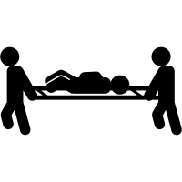
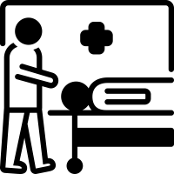
The British sector of the Western Front: Treatment
Regimental aid post and stretcher bearers
Field ambulances, dressing station and triage
Casualty Clearing Stations
Base Hospitals
Their job was to recover men from the battlefield and carrying them to aid posts which were often temporary stations where they could be quickly assessed and a decision made over the seriousness of the injury.
Typically 16 stretcher bearer per 1000 soldiers. These posts often had few resources e.g. bandages and morphine.
Field ambulances were often ¼ mile behind the front line.
Here they would provide basic care such as dressing the wounds and deciding on the seriousness of the injury.
They would then send them on to the appropriate place.
Serious cases were passed to casualty clearing stations by motorised or horse-drawn carriages.
Situated a few miles behind the front line, based in huts or tents.
Contained around 7-10 doctors, nurses and other orderlies (assistants).
They had access to mobile x-ray units and surgery could be carried out.
Could accommodate up to 50 soldiers. Triage decided what would happen to injured soldiers:
Less severely would be put on trains and sent to base hospital
Another group of severely injured soldiers who needed major treatment such as limb amputation or sewing up of wounds
Those beyond help would be made comfortable and provided with morphine or other pain killing drugs to make their last few hours comfortable
Treated the seriously wounded.
These could be civilian hospitals or converted buildings – situated near railways so patients could be moved on quickly.
Contained x-ray units, operating theatres and labs.
Those who needed attention that was not severe but bad enough to be sent back to England would be loaded onto trains.

Slide 10
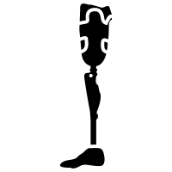
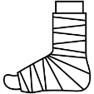
The British sector of the Western Front: Developments
Vaccinations – by 1915 22 out of every 1000 deaths was due to tetanus or typhus. From 1915 onwards a vaccination was introduced which reduced the number of these deaths to 2 in every 1000.
Amputations and artificial limbs – Limbs were often amputated to prevent gangrene. The war saw considerable development of artificial limbs and moving joints.
Plastic surgery – Devastating injuries from bullets and shrapnel led to the development of plastic surgery to mask injuries, particularly facial ones. Harold Gillies (British Army surgeon) opened a specialist facility at Queen’s Hospital in Kent to treat facial injuries. 1000 beds and treated over 2000 soldiers from the Battle of the Somme. New techniques were used to rebuild noses and they discovered how to graft skin.
Brain surgery – Blood transfusions and x-ray machines helped this process. US surgeon developed a surgical magnet to extract bullets and shrapnel from head wounds. Many surgeons who developed techniques in the war became specialists after the war was over.
Thomas Splint – reduced death rates from femur trauma from 80% to 20%. Stabilised the fracture by putting the leg lengthways to stop the bones grinding. This resulted in less amputations which were very dangerous with femur injuries due to blood loss. The idea of the Thomas Splint is still used today.
Aspetic surgery – the techniques developed by Lister were used when they were available but infection was a huge risk due to the unhygienic conditions. Carbolic acid and hydrogen peroxide were used to sterilise wounds but due to penicillin not being discovered many did die from infection.
Blood transfusion – They understood about blood groups but it was extremely difficult to store blood without it clotting. US scientist discovered sodium citrate could be safely mixed with blood to prevent clotting.

