Slide 1


Over the last few weeks in Session Zero, you should have looked at the following revision strategies:
Revision Method 1 – Reduce and Explain
Revision Method 2 – The Power of Symbols
Revision Method 3 – Spider Diagrams
Revision Method 4 - Making Flash Cards
Today:
Revision Method 5 – Test your memory
How do you revise?

Slide 2
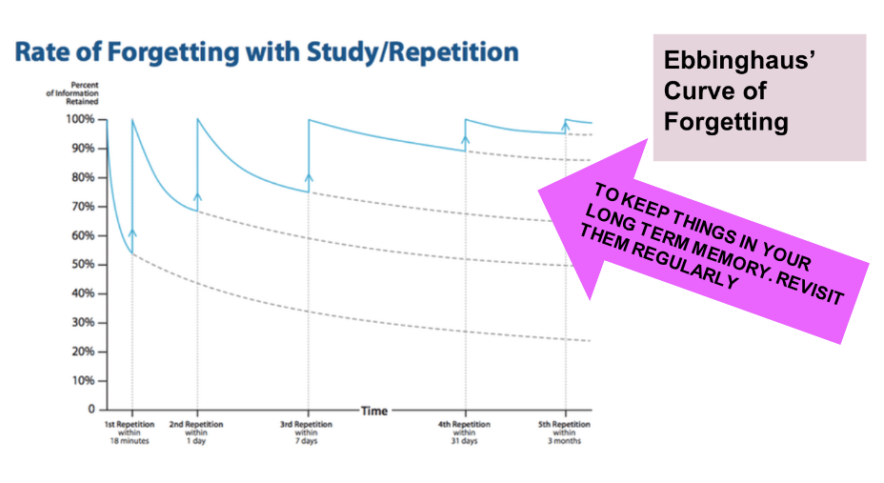
Forgetting and Retrieval
Notes:
A reminder – if you don’t revisit what you have learned. It is scientifically proven that you will forget. This means you will have to CATCH UP. If you use resources such as GCSEPod and the revision methods you have been taught, science proves that you will KEEP UP

Slide 3
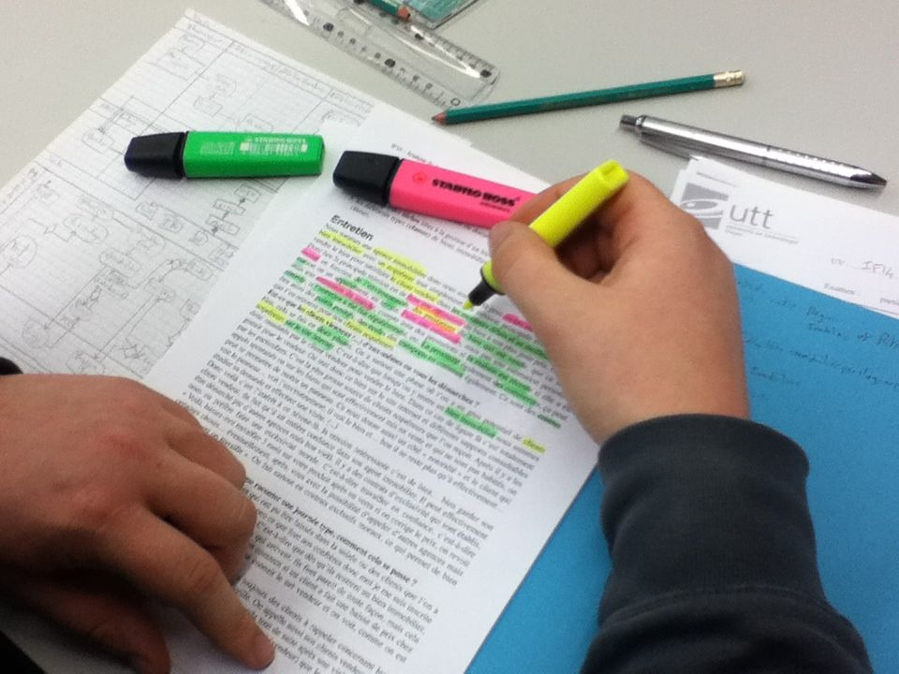
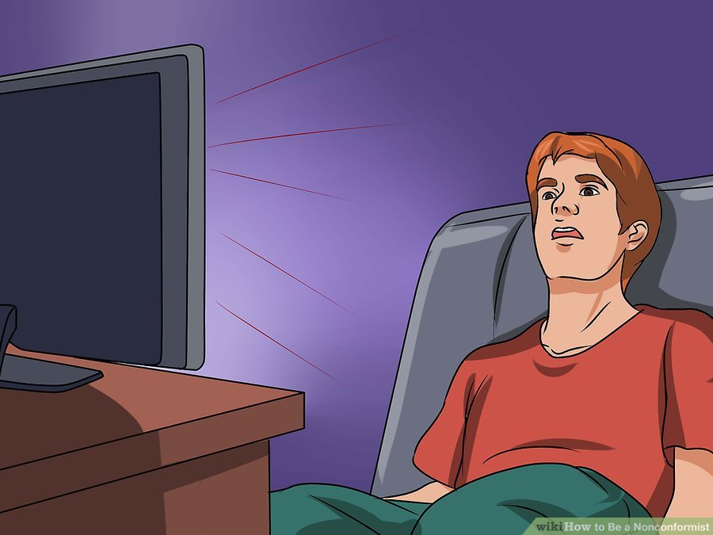
What does not work?
Re-reading
Highlighting
Cramming
Re-Writing
Notes:
What we know doesn’t work
The science of learning has also told us there are several ineffective revision strategies which remain popular. Students often feel as they have been ‘busy’ doing these, they are revising hard. However, they have little impact
Re-reading – this gives a false sense that you ‘know it’. However, your brain isn’t doing any hard work or learning
Highighting – it wastes time and leaves you focusing on a narrow area, often missing the big picture of the notes
Cramming – This essentially overloads your working memory, you cant learn it all. It causes stress/anxiety before exams
Re-writing – writing out your notes again isn’t making your brain do any hard work, it simply wastes time.

Slide 4
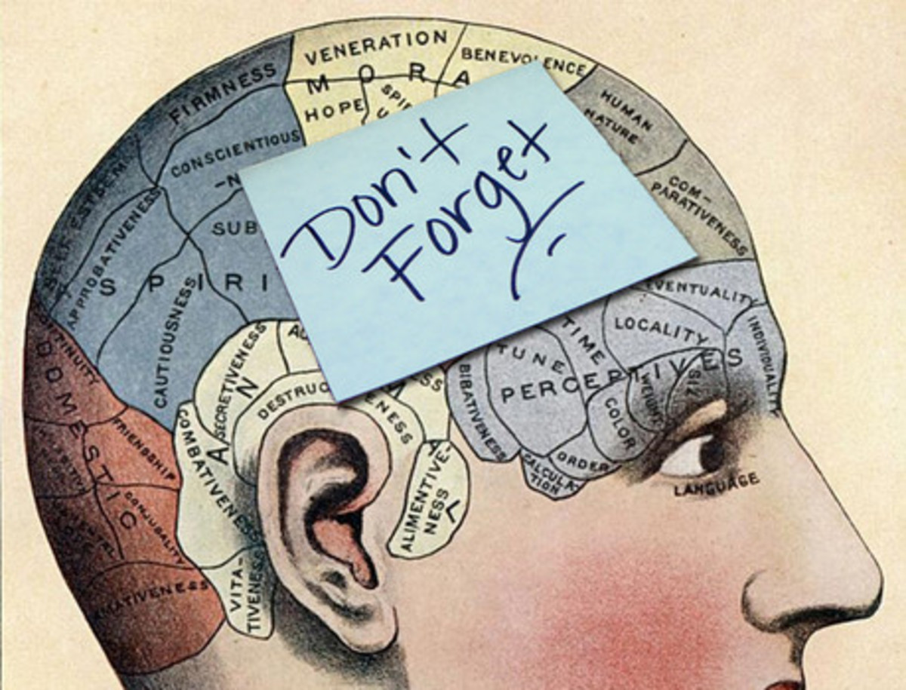
Pod Revision Method 5 – Test Your Memory
The Science:
the reason you might struggle to remember things is because your brain is so efficient. When the brain sees things that are familiar and unthreatening, it tends to register them as unimportant. If you want to remember things, you have to make your brain stop and take note.#
The more times you encounter something, the more likely you are to recall it. Therefore, it is better to cover the same thing several times for short periods, rather than spend a long time revising the same material on just one occasion.
Notes:
Please model how to create a flashcard using a pod from GCSEPod.
Ensure you explain the importance of not overloading information
And the importance of using the flashcards to test yourself by explaining aloud or asking a friend or family member to test you

Slide 5

Pod Revision Method 5 – Test Your Memory
Watch a Pod or read your revision once and then list 5 or more pieces of information from memory. Watch or read a second time to check the information you remembered is correct. Aim to improve on this score next time.
Stretch: Can you add another 3+ pieces of information after your second watch?
Other revision tips are available at Revision Night Club

