Slide 1
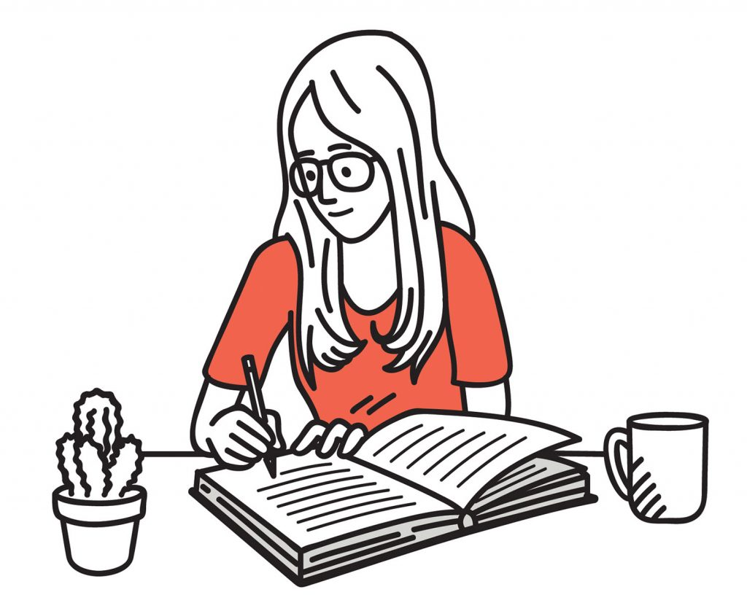

The Science of Learning
How memory works
Understanding the basics of memory, helps you understand how someone should learn and revise
Short Term Memory – ‘Working Memory’
This is where you do your thinking and where you take in new information e.g. what you see/hear/experience
Unless you think about it, most of it is forgotten
It holds a limited amount of information, and can get overloaded!
Long Term Memory
This is where new information is stored, what you have learned – when you remember something, it comes from here
It can hold an endless amount of information
The information gets forgotten if we don’t use it
Learning =
Learning = a change in your long term memory
Notes:
Short Term Memory
This is where you do your thinking and where you take in new information e.g. what you see/hear/experience
Unless you think about it, most of it is forgotten
It holds a limited amount of information, otherwise is gets overloaded and doesn’t learn anything. So, cramming is a bag idea!
Long Term Memory
This is where new information is stored, what you have learned – when you remember something, it comes from here
It can old an endless amount of information
The information gets forgotten if we don’t use it
Learning
Learning = a change in your long term memory
For information or skils to be learnt and stored in your long-term memory, the mind must work hard.
Therefore, when doing any revision activity, you must do things which actively make you think hard!

Slide 2

Over the last few weeks in Session Zero, you should have looked at the following revision strategies:
Revision Method 1 – Reduce and Explain
Revision Method 2 – The Power of Symbols
Revision Method 3 – Mind Maps
Today:
Revision Method 4 - Making Flash Cards
How do you revise?

Slide 3
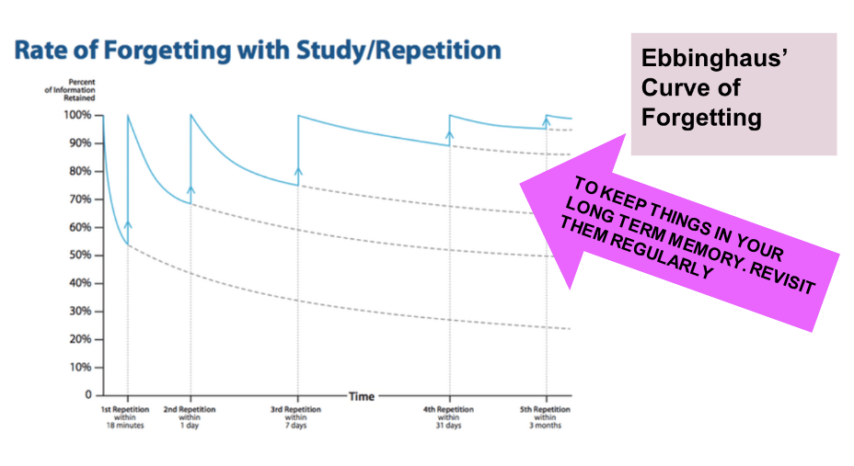
Forgetting and Retrieval
Notes:
A reminder – if you don’t revisit what you have learned. It is scientifically proven that you will forget. This means you will have to CATCH UP. If you use resources such as GCSEPod and the revision methods you have been taught, science proves that you will KEEP UP

Slide 4
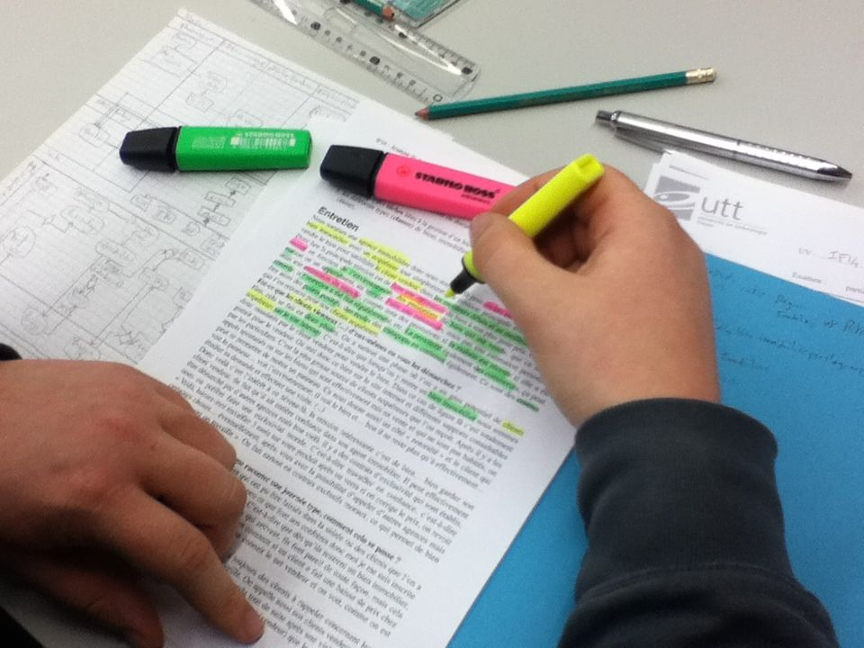
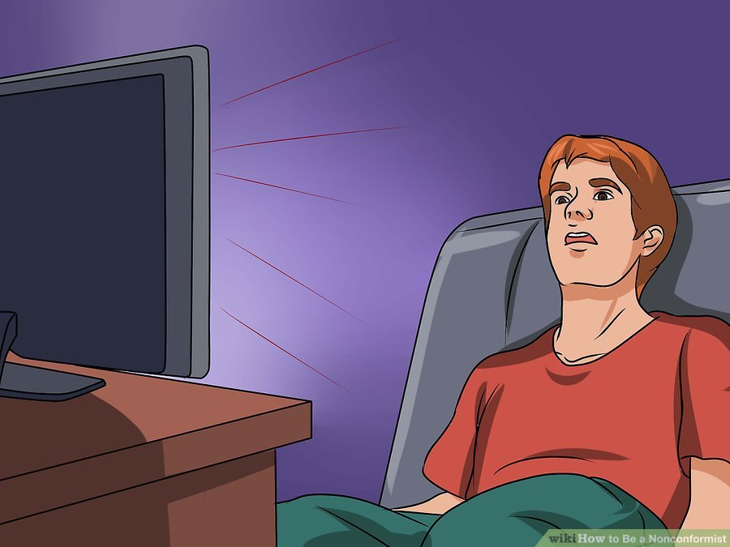
What does not work?
Re-reading
Highlighting
Cramming
Re-Writing
Notes:
What we know doesn’t work
The science of learning has also told us there are several ineffective revision strategies which remain popular. Students often feel as they have been ‘busy’ doing these, they are revising hard. However, they have little impact
Re-reading – this gives a false sense that you ‘know it’. However, your brain isn’t doing any hard work or learning
Highighting – it wastes time and leaves you focusing on a narrow area, often missing the big picture of the notes
Cramming – This essentially overloads your working memory, you cant learn it all. It causes stress/anxiety before exams
Re-writing – writing out your notes again isn’t making your brain do any hard work, it simply wastes time.

Slide 5
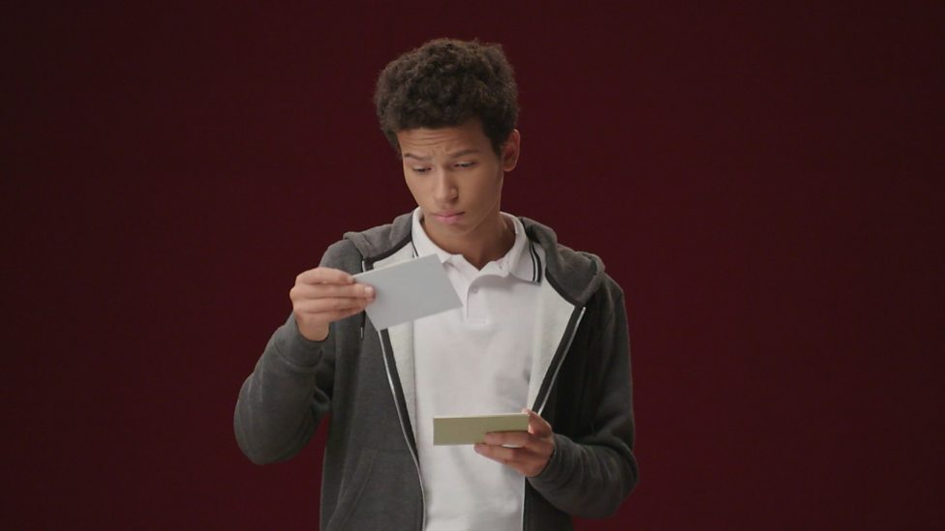
Pod Revision Method 4 – Making Flash Cards
The Science:
According to Prof Dunlovsky, “students who can test themselves or try to retrieve material from their memory are going to learn that material better in the long run.”
Start by reading or watching a video, then make flash cards of the most important parts and test yourself. A century of research has shown that repeated testing works.
You should use the flash cards to help you with:
Explaining a point or fact you are learning to another person.
Explaining to yourself, without prompts, how a problem is solved or how facts relate to each other.
Switching between different subjects and/or types of questions.
Notes:
Please model how to create a flashcard using a pod from GCSEPod.
Ensure you explain the importance of not overloading information
And the importance of using the flashcards to test yourself by explaining aloud or asking a friend or family member to test you

Slide 6
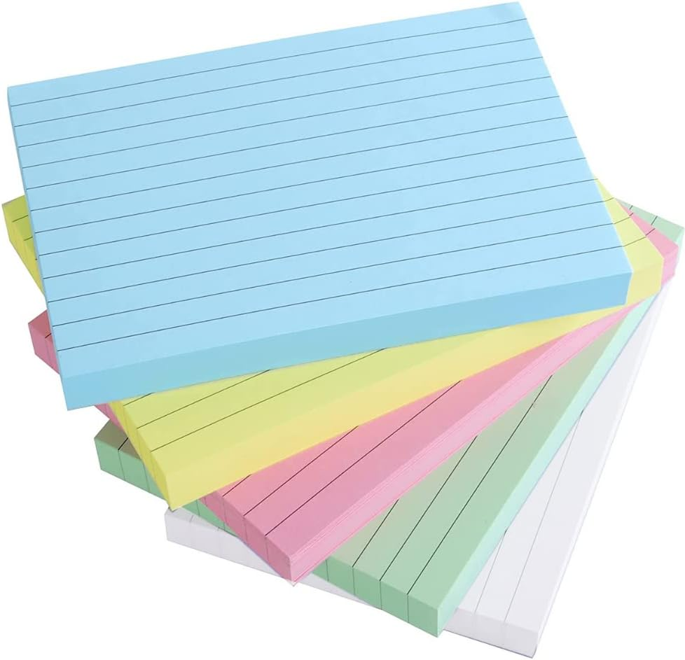
Pod Revision Method 4 – Making Flash Cards
If you are unsure what to put on a flashcard – think simple!
Choose small chunks of information and use the cards as prompts for yourself to explain to yourself or your partner in more detail
TOP TIP:
Use the GCSEPod ‘Check and Challenge’ quizzes to help you with content for your flashcards. They even have useful hints that you can steal for your own cards!

