Slide 1


The Science of Learning
How memory works
Understanding the basics of memory, helps you understand how someone should learn and revise
Short Term Memory – ‘Working Memory’
This is where you do your thinking and where you take in new information e.g. what you see/hear/experience
Unless you think about it, most of it is forgotten
It holds a limited amount of information, and can get overloaded!
Long Term Memory
This is where new information is stored, what you have learned – when you remember something, it comes from here
It can hold an endless amount of information
The information gets forgotten if we don’t use it
Learning =
Learning = a change in your long term memory
Notes:
Short Term Memory
This is where you do your thinking and where you take in new information e.g. what you see/hear/experience
Unless you think about it, most of it is forgotten
It holds a limited amount of information, otherwise is gets overloaded and doesn’t learn anything. So, cramming is a bag idea!
Long Term Memory
This is where new information is stored, what you have learned – when you remember something, it comes from here
It can old an endless amount of information
The information gets forgotten if we don’t use it
Learning
Learning = a change in your long term memory
For information or skils to be learnt and stored in your long-term memory, the mind must work hard.
Therefore, when doing any revision activity, you must do things which actively make you think hard!

Slide 2
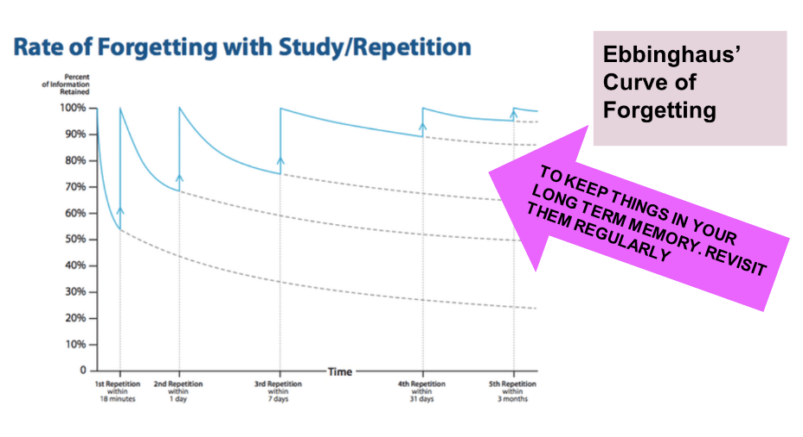
Forgetting and Retrieval
Notes:
We also know that information and skills are naturally forgotten if not revisited or practiced.
Research shows that over time you foget a majority of what you’ve learnt, it happens immediately.
Practice and retrieval helps break the forgetting curve and it strengthens long term memory – it stops the information ‘fading’ from your long-term memory
Retrieval helps organize information in your memory, making it easier and quicker to remember in the future
Retrieval helps you learn even more, knowledge is sticky!

Slide 3
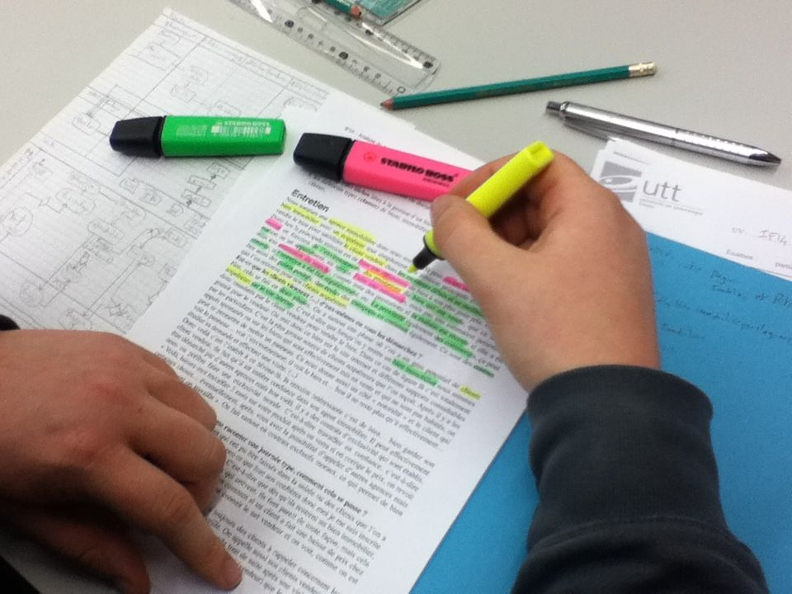

What does not work?
Re-reading
Highlighting
Cramming
Re-Writing
Notes:
What we know doesn’t work
The science of learning has also told us there are several ineffective revision strategies which remain popular. Students often feel as they have been ‘busy’ doing these, they are revising hard. However, they have little impact
Re-reading – this gives a false sense that you ‘know it’. However, your brain isn’t doing any hard work or learning
Highighting – it wastes time and leaves you focusing on a narrow area, often missing the big picture of the notes
Cramming – This essentially overloads your working memory, you cant learn it all. It causes stress/anxiety before exams
Re-writing – writing out your notes again isn’t making your brain do any hard work, it simply wastes time.

Slide 4
Pod Revision Method 3 – Mind Maps
The Science
What is a Mind Map?
A Mind Map is a visual brainstorming technique. You lay out your ideas to look a little like a spider, with a main idea in the middle and lines that branch out to add more insights or connected ideas.
Why should I use a Mind Map?
Think quickly and visually: Mind Maps are quick and simple to make. They are easy for our brains to understand because, unlike written notes, they closely reflect how our brains are structured.
Increase focus and comprehension: A Mind Map forces you to focus on the whole topic
Spark creativity: A Mind Map helps you to sort through information as you create your diagram, make new connections, increase understanding, and helps create additional ideas.
Remember more: These diagrams are memorable thanks to their colours, pictures and simple keywords. Plus, the act of building a Mind Map helps you more easily recall the information.

Slide 5
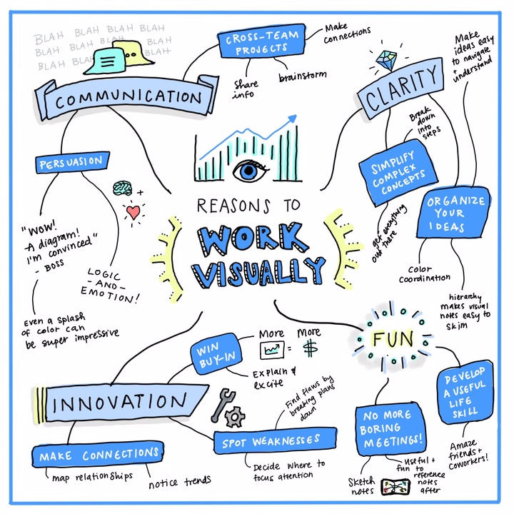

Slide 6

Pod Revision Method 3 – Mind Map
Create a Mind Map or mind map of the information in the Pod. Making it as colourful as possible will help you visualise it later.
Stretch: Can you link this mind map to another Pod, building on it with the new information from each Pod you watch?
Notes:
Choose a pod to watch with the class (from your subject area or any relevant to all pupils such as keeping fit and heathy, study smart or British values)
With the class, model how you would create a Mind Mapto help you remember the content of the pod
After, explain why you chose to include the information you have included in your Mind Map
Repeat the process, asking pupils to this time practice creating their own Mind Maps

