Slide 1
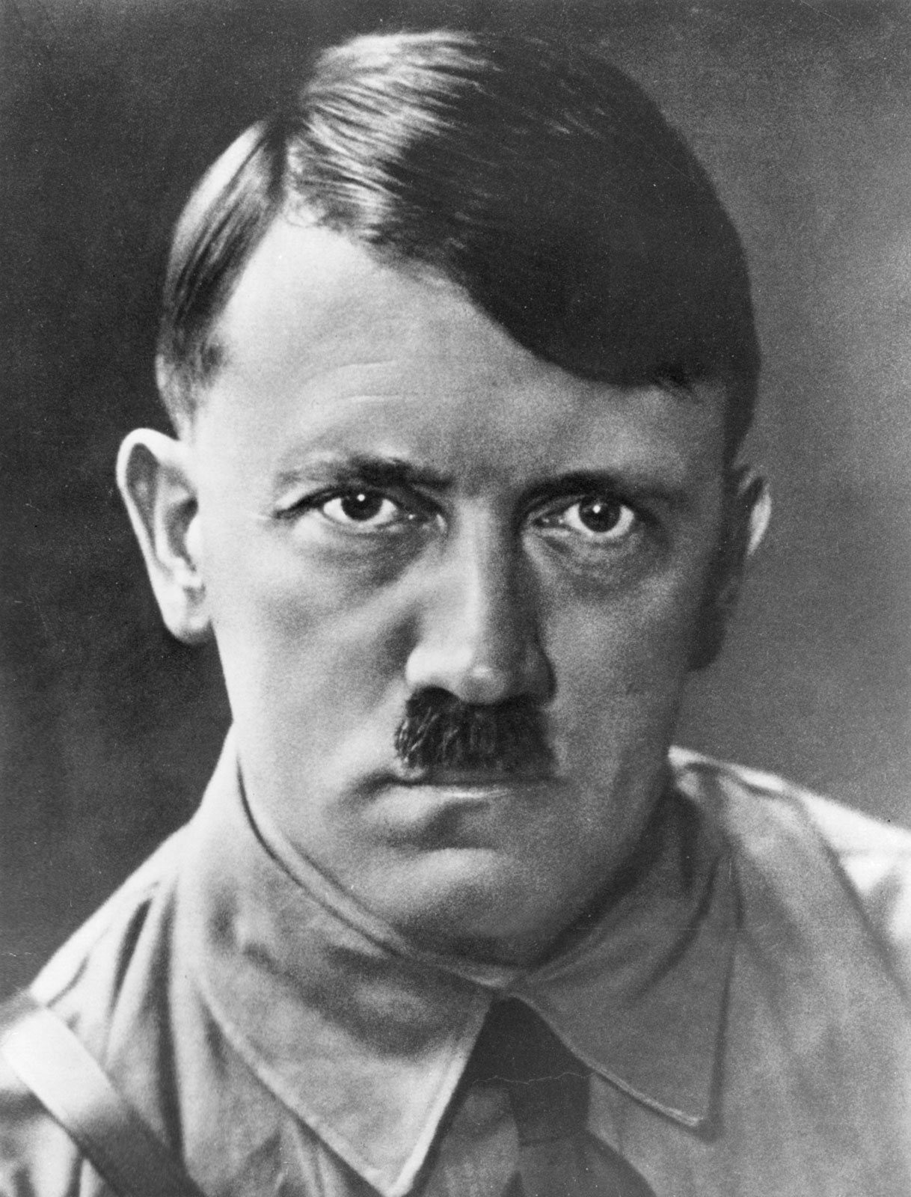
Topic | Confidence
 | R | A | G
Impact of World War One
Recovery of Weimar
Rise of Nazis and fall of Weimar
Consolidation of power
Life in Germany
Terror and persuasion
Hitler’s foreign policy
Germany Revison Booklet

Slide 2
The Impact of the First World War
Weaknesses of the Weimar Government
Political violence – there were communist and right wing uprisings including the Munich putsch. The Freikorps (soldiers) had to keep the peace but even they took part in a putsch (the Kapp putsch).
Hyperinflation- Germany couldn’t afford to pay the repartitions and France had invaded the Ruhr. The government printed more money and it became worthless, this was bad for those with savings (mostly the middle classes).
Weak constitution- article 48 gave emergency powers to the president, proportional representation led to unstable coalitions.
Treaty of Versailles Germans hated it because they lost land (Alsace Lorraine), army (no tanks aircraft or submarines) money (6600 million), blame (war guilt clause).Germans hated it because they lost land (Alsace Lorraine), army (no tanks aircraft or submarines) money (6600 million), blame (war guilt clause).

Slide 3
The Recovery of Weimar
Foreign
Policy
Locarno Pact – Deal with France, UK, Belgium & Italy that rebuilt trust.
Kellogg-Briand Pact – 64 other countries signed this – armies would be used for defence.
Young Plan – Lowered the total reparations and extended the repayment length.
Economic
Policy
Dawes Plan – Set up American loans to help Germany. Lowered amount to be paid each year.
Rentenmark – A temporary new currency. Followed by Reichsmark.
Germany joined the League of Nations
Stresemann’s recovery of the Weimar Republic

Slide 4
1929 – Wall St Crash – American economy collapsed.
US loaned money to Germany, now they want it back.
The Great Depression followed.
By 1932, 6 million unemployed, businesses went bust, people lost their homes, food prices fell and people starved.
The Weimar Government did not help the German people enough.
End of Weimar Republic
Now the Nazis got more support they promised bread and work.
The Nazis increased support by using propaganda.
Hitler increased support by using public speaking which he was excellent at.
Hitler increased support through punishing all opposition through using his SA to beat up those against him.
The Political Deal - In the 1932 election the Nazis became the largest party in the Reichstag but President Hindenburg refused to make Hitler Chancellor instead he made Von Schleicher Chancellor.
Von Papen wanted power so he persuaded Hindenburg to make Hitler Chancellor and he would be vice Chancellor. Hindenburg and Von Papen believed they could control Hitler.
30th January 1933 Hitler became Chancellor of Germany.
The Rise of the Nazi party

Slide 5
The Enabling Act
Hitler wanted full power of the Reichstag so he introduced the Enabling law. He held an election and needed 2/3 of the Reichstag to vote for him so he could do whatever he wanted.
He did 3 things:
Made a deal with some parties (The centre party)
Threw the communists out
Surrounded the Reichstag with the SA so people felt too afraid to vote against Hitler.
His new powers meant that:
Hitler banned all parties apart from the Nazis
Hitler can control of the media
The Reichstag Fire
27 February - Marinus van der Lubbe arrested.
The Nazis blame the Communists – according to the Nazis, the fire was a Communist plot to destroy the government.
Hindenburg announces additional powers
The Law for the Protection of the People and the State.
Consolidation of Power
The Night of Long Knives
Hitler did not trust the SA and had disagreements with them over the army.
He had Rohm and 400 people from the SA shot.
The result of this was that the army now trusted Hitler.
Hindenburg’s death
In 1934 President Hindenburg died.
Hitler wanted to be both President and Chancellor.
He asked the German people and more than 90% said yes.
He was given a new title, Fuhrer (leader).
The Army Oath
After the night of the Long Knives, Hitler got the army to swear an oath to serve him.
This made Hitler very powerful.

Slide 6
RAD – 18-25 men, 6 months labour work, uniforms
Invisible Unemployment – Jews and women not included in unemployment figures
Rearmament – Conscription increased size of army. Factories started to make weapons
Building program – motorways, hospitals and schools were built
DAF – Nazi Trade Union – easy to keep control of the workers.
Strength Through Joy – Rewards programme for workers. Theatre trips and cruises. Volkswagen scheme was a lie.
Workers
lost progress from 1920s Weimar Germany
– no make up, long hair, long skirts.
– Medals encouraged them to have babies. Lebensborn. Loans provided to encourage marriage.
Women encouraged to stay at home, follow 3 K’s. (Children, Kitchen, Church
Women
Life in Germany
Textbooks – Rewritten to support Nazi myths.
Teachers – Had to be loyal Nazis (Nazi Teachers League)
Lessons – Started with “Heil Hitler”!
Curriculum – Focus on physical activity. Glorified Germany’s past
Education
Youth
Boys – Hitler Youth – Hiking, camping, marching and military drills.
Girls – League of German Maidens – Domestic skills, motherhood
Racial Policy – Aryans were a master race. All Jews were “subhuman” and must be destroyed.
Schools – Textbooks and lessons were anti-Semitic. Jewish children kicked out from 1938.
Laws – Nuremberg Laws, 1935 – Jews lost citizenship, no marriage or sexual relations.
Kristallnacht – November 1938 – Jewish shops and businesses attacked.
Jews

Slide 7
The SS
Hitler’s personal bodyguard
By 1934, had 50,000 members
Racially pure, Nazi elite
Education
Indoctrination of young people – changes in the school curriculum: textbooks and burning of books.
Cinema showed Nazi propaganda films, newsreels at beginning of show.
Concentration camps
First camp built in March 1933 in Dachau
Prisoners were categorised by a coloured triangle: e.g. Jewish, communist, gypsy, disabled etc.
People were questioned, tortured and used for hard labour at the camps.
Josef Goebbels – Minister for Propaganda and Enlightenment
Radio
Radio was controlled by the Nazis, listening to foreign stations was banned, radio wardens to check if people were listening to official broadcasts, loudspeakers to make broadcasts in public places. Radios were produced cheaply to encourage all Germans to own one so they could hear Hitler speak
Terror and Persuasion
Terror
Persuasion
The Gestapo
Secret state police
Set up in 1933, under control of SS in 1936
Could arrest/imprison anyone opposing the Nazis. Most of these people would be sent to concentration camps.
Would tap phones and open mail.
Control of the legal system
All judges had to sign up to Nazi ideals
All lawyers had to be members of the German Lawyers Front
Mass demonstrations and rallies e.g. Nuremburg rallies
Nazi controlled newspapers – strict censorship

Slide 8
Aims
Expand East (Lebensraum)
Anschluss (unite all Germans)
Tear up the treaty of Versailles
Rearming
Hitler started to build up the army.
Rhineland
Hitler marched troops into the Rhineland which broke the Treaty of Versailles (France and Britain did nothing)
Anschluss
Germany and Austria unified (1938)
Sudetenland
Britain and France gave Hitler part of Czechoslovakia if he promised not to invade the rest. This was called the Munich agreement. (1938)
Czechoslovakia
Hitler broke the Munich agreement and invaded the rest of Czechoslovakia. (1939)
Poland
Germany invaded Poland. Britain declared war. (1939)
Alliances
Anti – Comintern Pact with Japan
Pact of Steel with Italy
The Nazi Soviet Pact 1939 with USSR (aka. Ribbentrop/Molotov Pacts
Hitler’s Foreign Policy

